Slide 1


LEANDRO MANASSI PANITZ
29st September 2023

Slide 2

Outline
Executive Summary
Introduction
Methodology
Results
Conclusion
Appendix

Slide 3
Executive Summary
Summary of methodologies
Data Collection through API and Web Scraping
Data Wrangling
Exploratory Data Analysis with SQL
Exploratory Data Analysis with Data Visualization
Interactive Visual Analytics with Folium
Interactive Dashboard with Ploty Dash
Machine Learning Prediction
Summary of all results
Exploratory Data Analysis (EDA) results
Interactive Maps and Dashboard
Predictive Analytics results

Slide 4
Introduction
Project background and context
SpaceX promotes Falcon 9 rocket launches on its website at a price of $62 million. In contrast, other providers charge over $165 million per launch. A significant portion of these savings comes from SpaceX's ability to reuse the first stage of the rocket. With this in mind, the objective of this project is to analyze data from Falcon 9 launches and develop a predictive machine learning model to determine whether the first stage will land successfully. If we can predict this outcome, we can better estimate the cost of a launch. Such insights would be invaluable for any competing company looking to bid against SpaceX for rocket launch contracts.
Problems you want to find answers
The factors that determine whether a rocket will land successfully.
The interaction of the various factors that determine the success rate of a successful landing.
The ideal operating conditions to achieve the best landing success rate.

Slide 5

Section 1

Slide 6
Methodology
Executive Summary
Data collection methodology:
Collected through the SpaceX REST API
Web Scraping from Wikipedia
Perform data wrangling
Data filtering, dealing with missing values, data preparation with creation of new variables
Perform exploratory data analysis (EDA) using visualization and SQL
Perform interactive visual analytics using Folium and Plotly Dash
Perform predictive analysis using classification models
Building, tuning and evaluation of classification models to guarantee optimal outcomes

Slide 7
Data Collection
Data sets collected:
SpaceX API: Open Source REST API for launch, rocket, core, launchpad, and landing pad data
https://api.spacexdata.com/v4/
Wikipedia: List of Falcon 9 and Falcon Heavy launches
https://en.wikipedia.org/wiki/List_of_Falcon_9_and_Falcon_Heavy_launches

Slide 8
Data Collection – SpaceX API
Getting Response from Space X API
The data was obtained from the Open SpaceX API following the steps shown in the flowchart presented
GitHub URL of the completed SpaceX API calls notebook: https://github.com/lepanitz/IBM---Final-Project/blob/main/01%20jupyter-labs-spacex-data-collection-api.ipynb
Convert Response to JSON File
Request information about rockets, launchpads, payloads and core using custom functions
Create a dictionary with all data obtained
Create a dataframe from the dictionary
Export a dataframe to a CSV file

Slide 9
Data Collection - Scraping
Getting Response from Wikipedia HTML
The data was obtained from the Wikipedia Webpage following the steps shown in the flowchart presented
GitHub URL of the completed Wikipedia Web scraping notebook: https://github.com/lepanitz/IBM---Final-Project/blob/main/02%20jupyter-labs-webscraping.ipynb
Create a BeautifulSoup Object
Collecting data by parsing HTML tables
Create a dictionary with all data obtained
Create a dataframe from the dictionary
Export a dataframe to a CSV file

Slide 10
Data Wrangling
Imported the dataframe created from the SpaceX API (dataset_part_1.csv)
Through Data Wrangling, the data was cleaned, unified and organized and Exploratory Data Analysis (EDA) was carried out
GitHub URL of the completed Data Wrangling notebook: https://github.com/lepanitz/IBM---Final-Project/blob/main/03%20labs-jupyter-spacex-Data%20wrangling.ipynb
Calculated the number of launches on each site
Calculated the number and occurrence of each orbit
Calculated the number and occurence of mission outcome of the orbits
Created a landing outcome label from Outcome column
Exported a dataframe to a CSV file (dataset_part_2.csv)

Slide 11
EDA with Data Visualization
Charts Plotted:
Relationship between Flight Number and Launch Site
Relationship between Payload and Launch Site
Relationship between success rate of each orbit type
Relationship between Flight Number and Orbit type
Relationship between Payload and Orbit type
Launch success yearly trend
Through the plotted graphs it was possible to visualize the existence or not of relationships between the variables in order to understand how they affect successful landings.
GitHub URL of the completed EDA with Visualization notebook: https://github.com/lepanitz/IBM---Final-Project/blob/main/05%20jupyter-labs-eda-dataviz.ipynb

Slide 12
EDA with SQL
SQL queries performed:
Names of the unique launch sites in the space mission
5 records where launch sites begin with the string 'CCA’
The total payload mass carried by boosters launched by NASA (CRS)
Average payload mass carried by booster version F9 v1.1
Date when the first succesful landing outcome in ground pad was achieved
Names of the boosters which have success in drone ship and have payload mass greater than 4000 but less than 6000
Total number of successful and failure mission outcomes
Names of the booster_versions which have carried the maximum payload mass. Use a subquery
Records which will display the month names, failure landing_outcomes in drone ship ,booster versions, launch_site for the months in year 2015
Count of landing outcomes (such as Failure (drone ship) or Success (ground pad)) between the date 2010-06-04 and 2017-03-20, in descending order
We chose to use PostgreSQL to persist the data on a local machine.
GitHub URL of the completed EDA with SQL notebook: https://github.com/lepanitz/IBM---Final-Project/blob/main/04%20jupyter-labs-eda-sql-coursera_sqllite_postgree.ipynb

Slide 13
Build an Interactive Map with Folium
Mapping Launch Locations: All launch sites have been pinpointed on our interactive map.
Integration of Map Objects: To depict the success or failure of each launch, we employed a mix of markers, circles, and lines on the folium map.
Categorizing Launch Outcomes: We designated values to classify the outcomes of the launches: 0 stands for a failure, whereas 1 signifies success.
Visual Identification of Performance: Through color-labeled marker clusters (RED and GREEN), we can clearly discern which launch sites boast a higher success rate.
Distance Analysis: We computed the distances between a launch site and its nearby locations, offering insights about its strategic placement and potential influencing factors on launch success.
GitHub URL of the completed Analysis with Folium notebook: https://github.com/lepanitz/IBM---Final-Project/blob/main/06%20lab_jupyter_launch_site_location.ipynb

Slide 14
Build a Dashboard with Plotly Dash
Dashboard Creation: Leveraged Plotly Dash to develop a dynamic and user-friendly interface.
Launch Site Analysis: Introduced pie charts to depict the distribution of total launches across specific sites, allowing for a comparative view.
Exploring Outcome vs. Payload Dynamics: Utilized scatter graphs to visualize the correlation between launch outcomes and payload mass in kilograms, segmented further by various booster versions.
Diverse Visualization Tools: Integrated both categorical and continuous data types for a comprehensive understanding of launch patterns.
GitHub URL of the completed Dashboard with Plotly Dash notebook: https://github.com/lepanitz/IBM---Final-Project/blob/main/07%20spacex_dash_app.py

Slide 15
Predictive Analysis (Classification)
Data Preparation: Loaded datasets using numpy and pandas, followed by necessary transformations.
Data Splitting: Segmented the data into training and testing sets to validate the model's performance.
Model Building: Developed various machine learning models and optimized hyperparameters using GridSearchCV.
Evaluation Metric: Employed accuracy as the primary metric to assess and refine our model's performance.
Model Optimization: Continual enhancement of the model through feature engineering and algorithm tuning.
Highlighting the Best Model: Identified and spotlighted the top-performing classification model after all adjustments.
GitHub URL of the completed Predictive Analysis notebook: https://github.com/lepanitz/IBM---Final-Project/blob/main/08%20SpaceX_Machine_Learning_Prediction_Part_5.jupyterlite.ipynb

Slide 16
Results
Outcomes are divided into three primary categories:
Initial Insights: Conclusions drawn from exploratory data analysis.
Visual Demonstrations: Screenshots showcasing the interactive analytics experience.
Predictive Outcomes: Results and findings from the predictive analysis phase.

Slide 17

Section 2

Slide 18
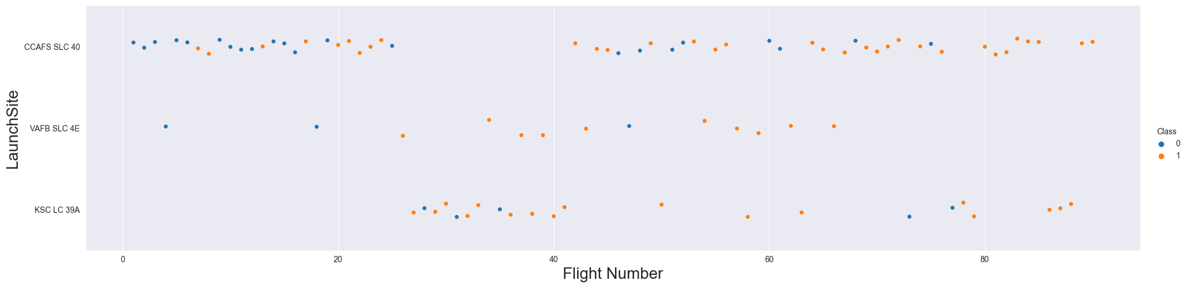
Flight Number vs. Launch Site
The success rate increases with the number of flights.
Launch sites with a higher number of flights tend to have a greater success rate.

Slide 19
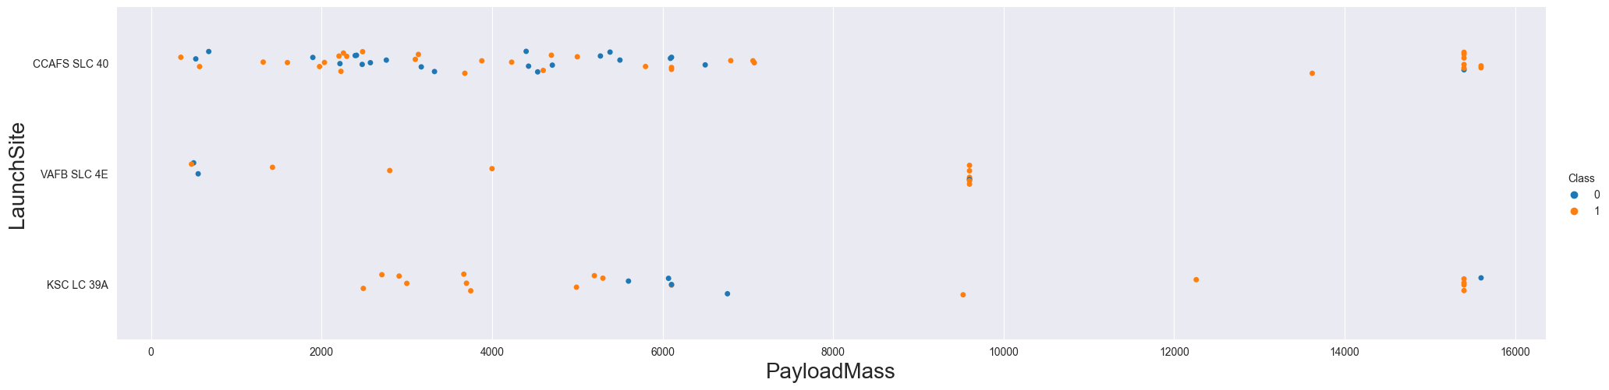
Payload vs. Launch Site
The KSC LC 39A and CCAFS SLC 40 launch sites are more suitable for payloads greater than 12,000 kg.
Independente do local de lançamento, voos com carga maior do que 8.000 tem uma taxa de sucesso de lançamento maior.

Slide 20
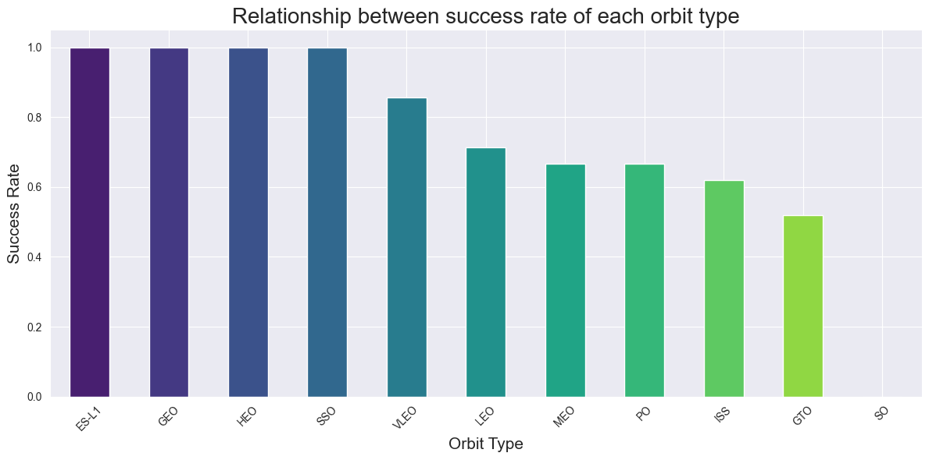
Success Rate vs. Orbit Type
Das 11 órbitas possíveis, 4 órbitas (ES-L1, GEO, HEO e SSO) apresentam uma de taxa de sucesso de 100%.

Slide 21
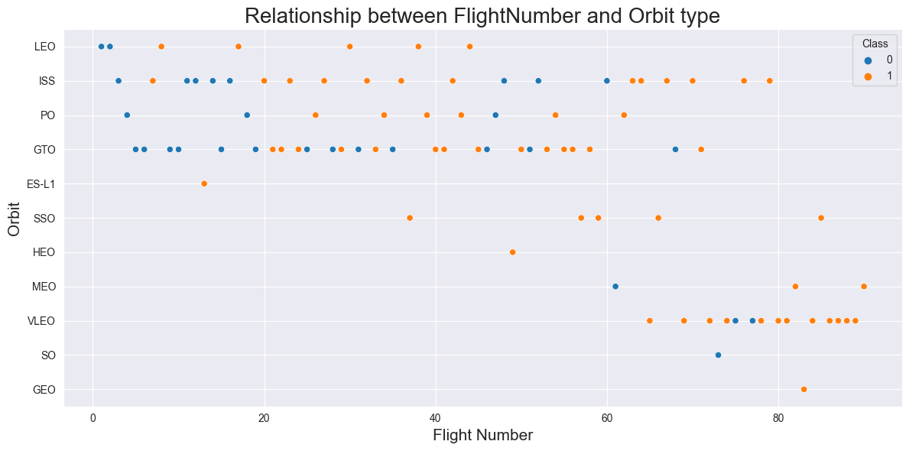
Flight Number vs. Orbit Type
A taxa de sucesso aumenta em praticamente todas as órbitas.
As órbitas mais utilizadas são a ISS e a GTO.
Parece haver uma migração de voos para a órbita VLEO mais recentemente.

Slide 22
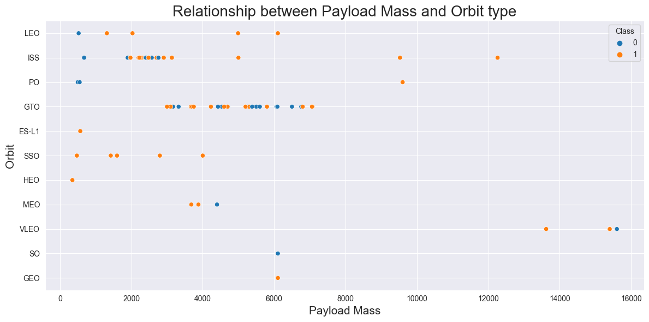
Payload vs. Orbit Type
As órbitas ISS, PO e VLEO são preferenciais para maiores cargas.
As órbitas ES-L1, SSO, HEO, LEO, ISS e MEO são preferenciais para menores cargas.

Slide 23
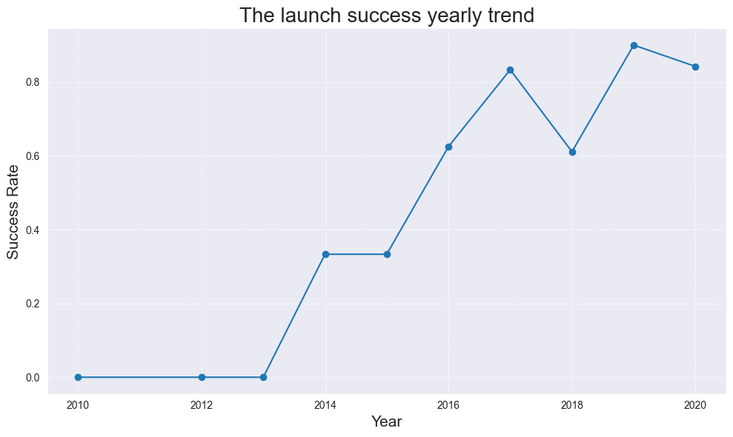
Launch Success Yearly Trend
Desde 2013 as taxas de sucesso dos foguetes da Space X vem crescendo.

Slide 24
All Launch Site Names
Find the names of the unique launch sites
Present your query result with a short explanation here

Slide 25
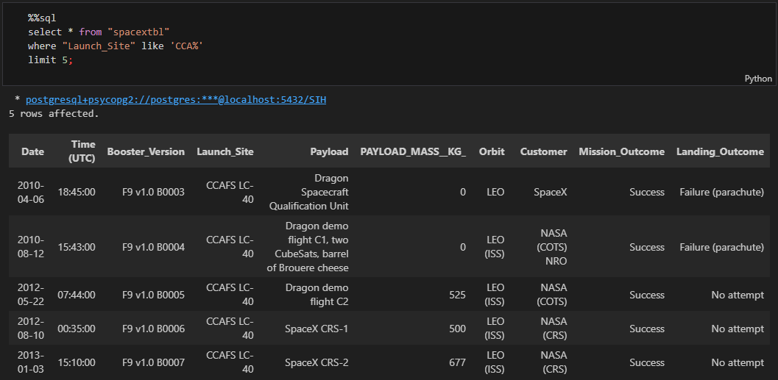
Launch Site Names Begin with 'CCA'
Query
Result
Explanation
Display 5 records where launch sites begin with the string 'CCA'

Slide 26
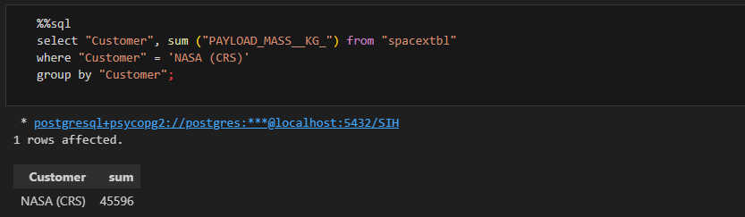
Total Payload Mass
Query
Result
Display the total payload mass carried by boosters launched by NASA (CRS)
Explanation

Slide 27
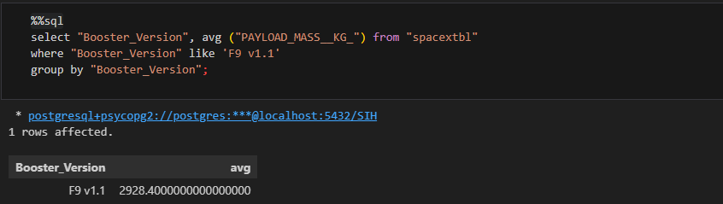
Average Payload Mass by F9 v1.1
Query
Result
Display average payload mass carried by booster version F9 v1.1
Explanation

Slide 28
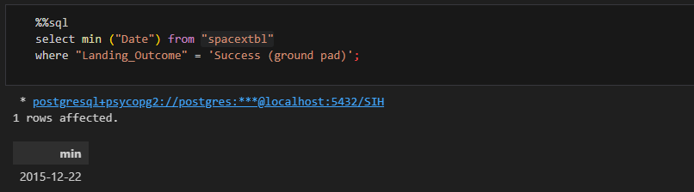
First Successful Ground Landing Date
Query
Result
Date when the first successful landing outcome in ground pad was achieved.
Explanation

Slide 29
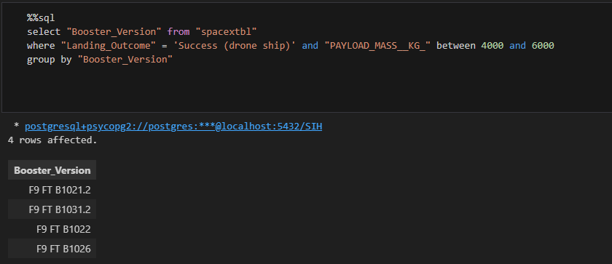
Successful Drone Ship Landing with Payload between 4000 and 6000
Query
Result
Names of the boosters which have success in drone ship and have payload mass greater than 4000 but less than 6000
Explanation

Slide 30
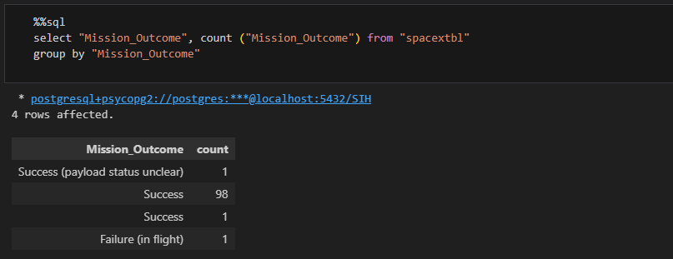
Total Number of Successful and Failure Mission Outcomes
Query
Result
Total number of successful and failure mission outcomes
Explanation

Slide 31
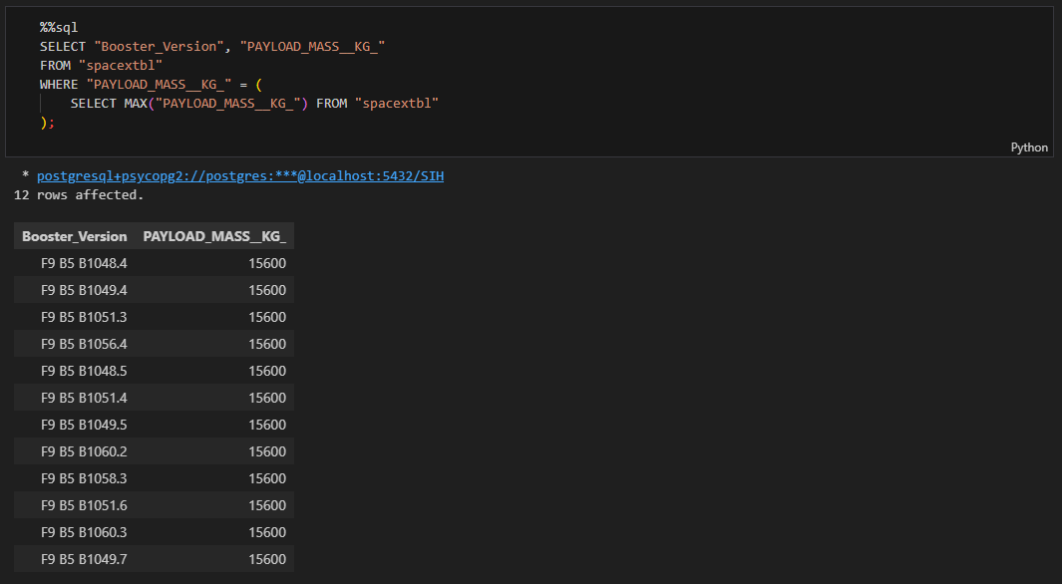
Boosters Carried Maximum Payload
Query
Result
Explanation
Names of the booster versions which have carried the maximum payload mass

Slide 32
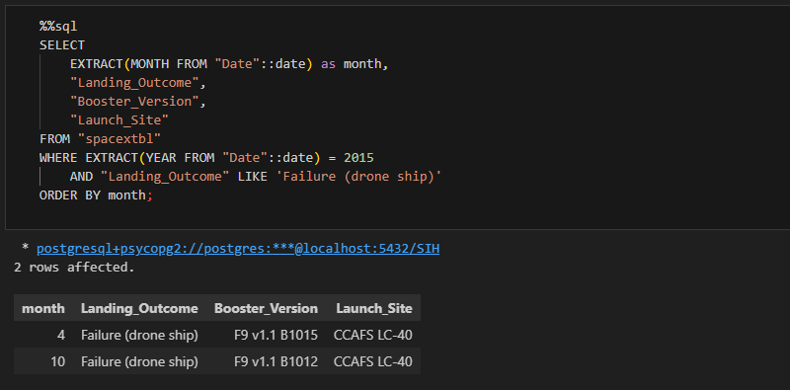
2015 Launch Records
Query
Result
Records which will display the month names, failure landing outcomes in drone ship ,booster versions, launch site for the months in year 2015.
Explanation

Slide 33
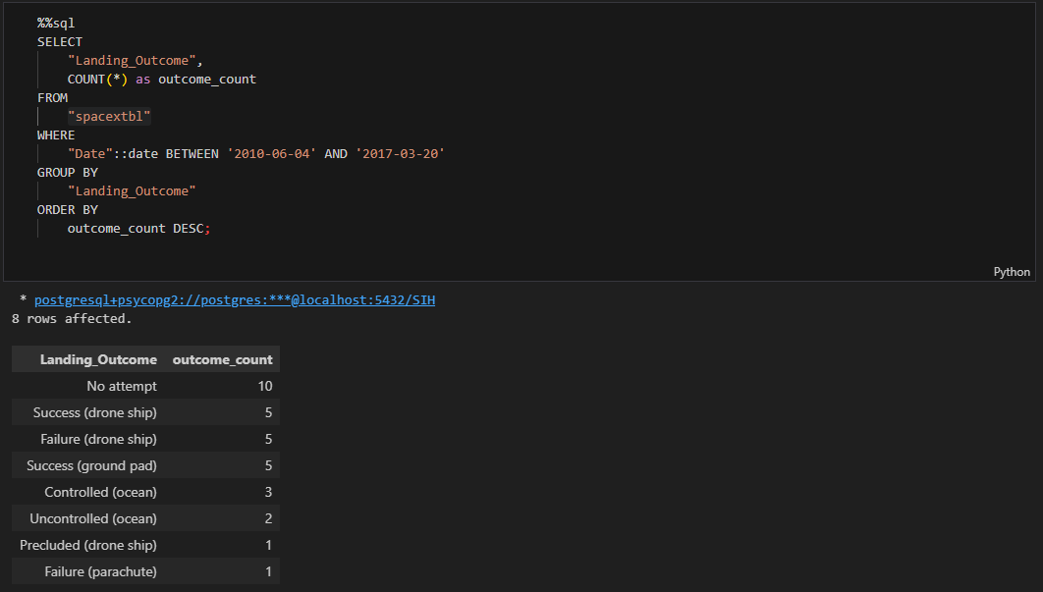
Rank Landing Outcomes Between 2010-06-04 and 2017-03-20
Query
Result
Count of landing outcomes (such as Failure (drone ship) or Success (ground pad)) between the date 2010-06-04 and 2017-03-20, in descending order.
Explanation

Slide 34

Section 3

Slide 35
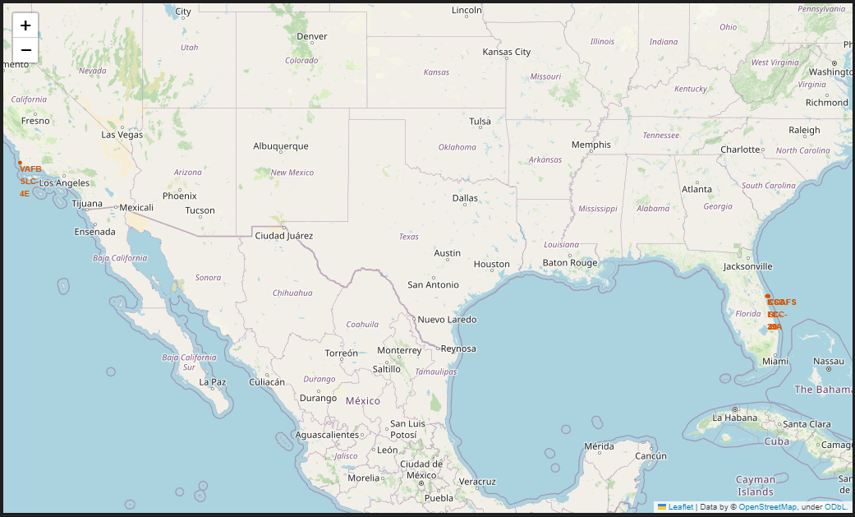
All launch sites map markers
The map displays the location of the four launch sites, which are on the east and west coast of the US.

Slide 36
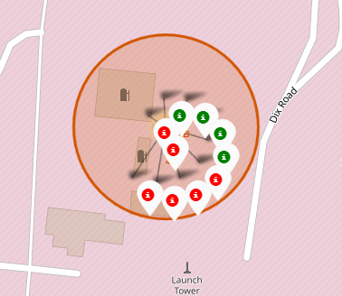
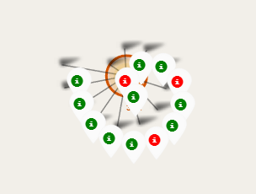
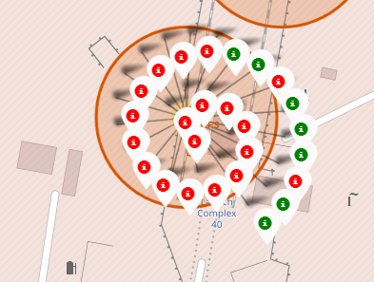
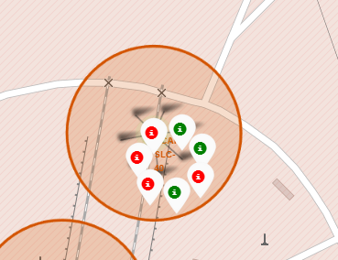
Markers indicate successful or failed launches for each site on the map.
VAFB SLC-4E
KSC LC-39A
CCAFS LC-40
CCAFS SLC-40
Success
Failure

Slide 37
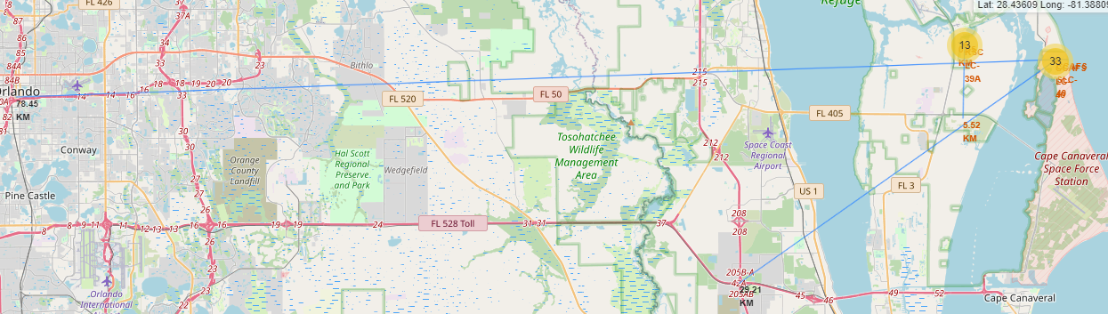
Distances between a launch site to its proximities
Launch sites are not in close proximity to railways.
Launch sites are not adjacent to highways.
Launch sites are located near coastlines.
Launch sites maintain a certain distance from cities.

Slide 38

Section 4

Slide 39
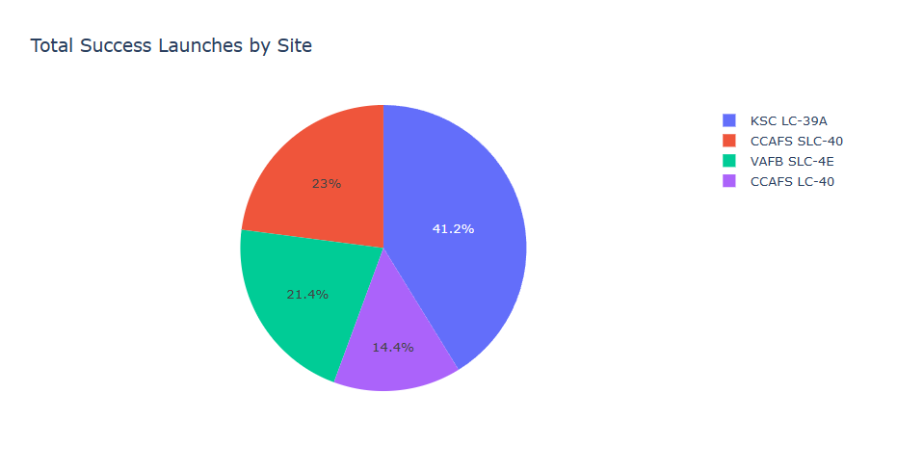
Success percentage achieved by each launch site
The KSC LC-39A launch site has the highest success rate compared to the other sites.

Slide 40
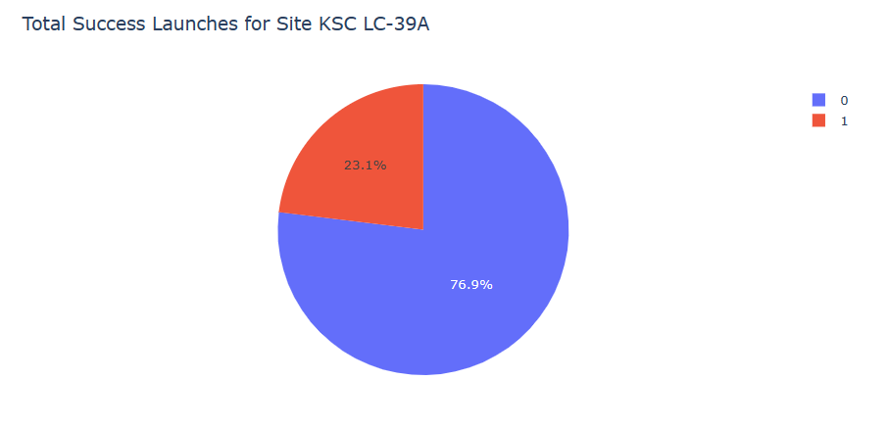
Launch site with the highest launch success ratio
The launch success ratio on the KSC LC-39A is 76.9%.

Slide 41
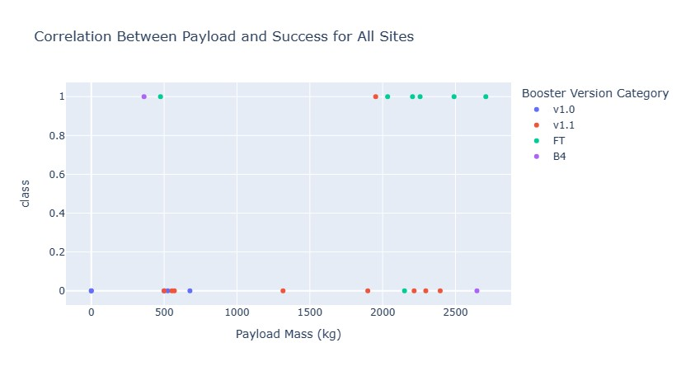
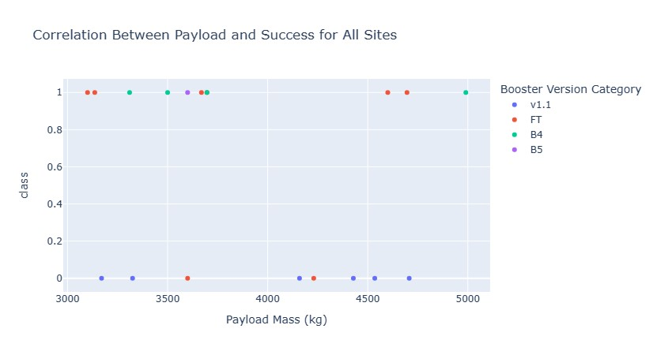
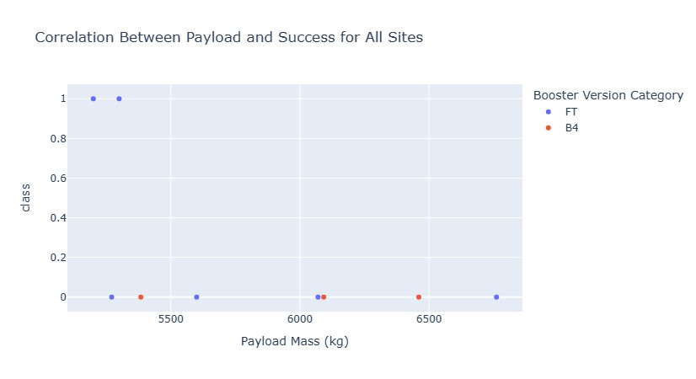
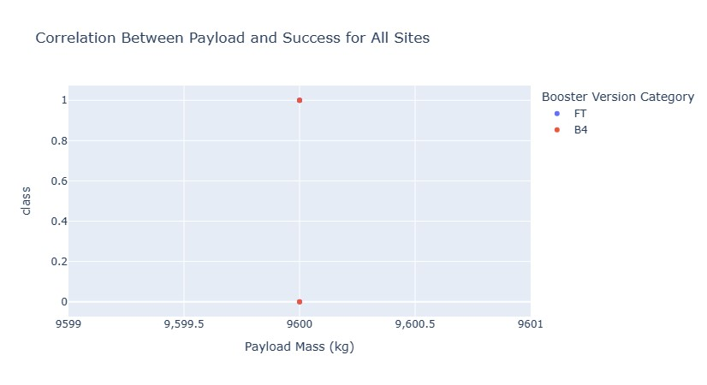
Payload vs Launch Outcome for all sites with different payload Mass
Lighter Payload Mass
Payload Mass
0 – 3,000
Payload Mass
3,000 – 5,000
Payload Mass
5,000 – 8,000
Payload Mass
8,000 – 10,000
Heaviest Payload Mass

Slide 42

Section 5

Slide 43
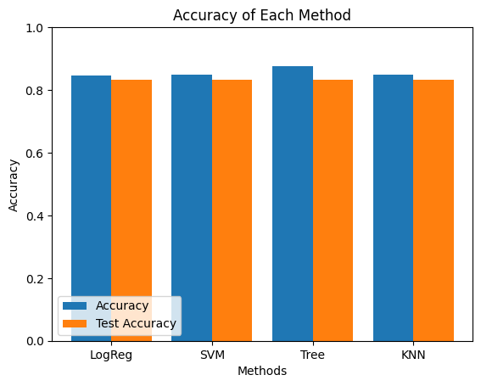
Classification Accuracy
The model with the highest classification accuracy is Decision Trees.

Slide 44

Confusion Matrix
Decision Tree Confusion Matrix

Slide 45
Conclusions
There is a direct correlation between the number of flights from a launch site and its success rate.
We observed a steady increase in launch success rates from 2013 through 2020.
The orbits ES-L1, GEO, HEO, SSO, and VLEO have the highest success rates.
Among all the launch sites, KSC LC-39A recorded the most successful launches.
The Decision Tree classifier proved to be the most effective machine learning algorithm for this analysis."

Slide 46


